Slide 1
Figure 1. XRD analysis of iron ore, slime and mill scale

Slide 2
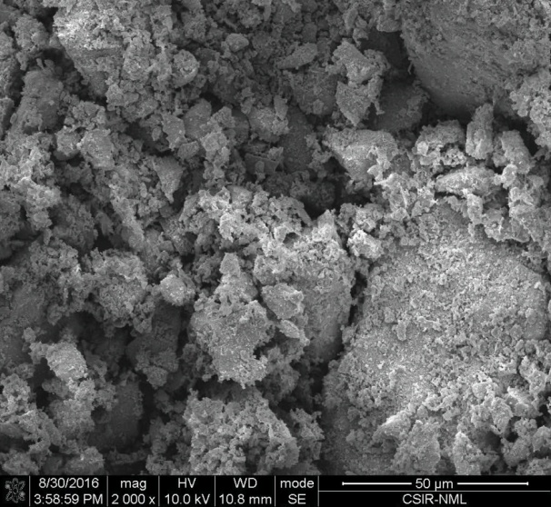
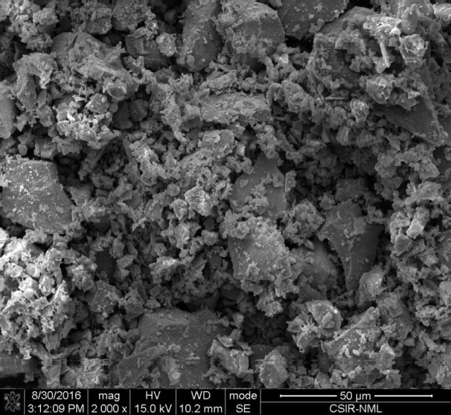
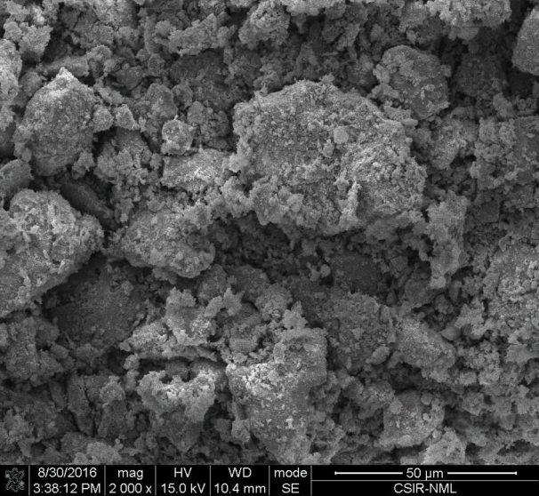
(a) Iron ore fine
(b) Mill scale fine
(c) Slime fine
Figure 2. Surface morphology of different fines under SEM microscope

Slide 3
Figure 3. Thermo-gravimetric analysis of several raw materials

Slide 4
Induration temperature: 1275 °C
Figure 4. Effect of Basicity on CCS and RDI of indurated fluxed pellet

Slide 5
Mill scale content: 15 wt%
Figure 5. Effect of increasing addition of iron ore slime on the CCS and Apparent Porosity of mill scale containing acidic hematite pellet

Slide 6
Figure 6. Optical microstructure of mill scale added acidic pellets with and without addition of iron ore slime

Slide 7
Figure 7. XRD pattern of mill scale added acidic pellet and with and without the addition of iron ore slime

Slide 8
Mill scale: 15 wt%
Figure 8. Effect of iron ore slime addition on RDI of mill scale added hematite pellet

Slide 9
Mill Scale: 15wt%
Basicity : 0.3
Figure 9. Effect of iron ore slime addition on the CCS of mill scale added basic hematite pellet

Slide 10
Mill Scale: 15 wt%
Basicity : 0.3
Induration temperature: 1275 °C
Figure 10. Effect of iron ore slime addition on the AP of mill scale added basic hematite pellet

Slide 11
(a) 15 wt % mill scale added pellet without slime (Indurated at 1275°C) (b) 15 wt% mill scale added pellet with 15% slime (Indurated at 1275°C)
Figure 11. XRD of mill scale added basic pellet (0.3 basicity) with and without the addition of iron ore slime

Slide 12
15 wt% mill scale added pellet without slime (Indurated at 1275°C)
15 wt% mill scale added pellet with 15 wt% slime (Indurated at 1275°C)
1:Hematite, 2: pore, 3: slag, 4: Magnesio ferrite
Figure 12. Optical microstructure of mill scale added basic pellet (0.3 basicity) with and without the addition of iron ore slime

Slide 13
Mill Scale: 15 wt%
Basicity : 0.3
Induration temperature: 1275 °C
Figure 13. Effect of iron ore slime addition on RDI of mill scale added basic hematite pellet

